Slide 1

Automation of analysis of comments from the UdL surveys
Universitat de Lleida
Escola Politècnica Superior
Marter’s Final Project
Student: David Sánchez Marín
Director: Roberto García González
July 2021

Slide 2

01 INTRODUCTION
Every year the University of Lleida, in particular
the Quality and Teaching Planning unit conducts a lot of
satisfaction surveys addressed to students, professors, staff, etc.
These surveys include:
Closed questions with valuation form 1 to 5
Free text comments
Problem: some of the comments include offensive expressions, descriptions of conflicts, errors in professors’ scheduling, etc.
I developed an application to process these comments.

Slide 3

01 OBJECTIVES
The main objectives of the application are:
Importation of surveys and comments
Use of Artificial Intelligence (AI) and Natural Language Processing (NLP) to analyze the comments.
Visualization of results and manual edition of comments.
Other objectives:
Use an Agile methodology: Behaviour Driven Development (BDD)
Test a framework of web development: Django and Python
Explore Natural Language Processing: Spacy library

Slide 4
01 QUATIFYCATION (by academic year)
75,000
14,000
350
Surveys
Comments
Issues
(2.5%)

Slide 5
INTRODUCTION
01
NATURAL LANGUAGE PROCESSING
02
TABLE OF CONTENTS
METHODOLOGY AND SCHEDULING
03
04
DEVELOPMENT
05
CONCLUSIONS

Slide 6
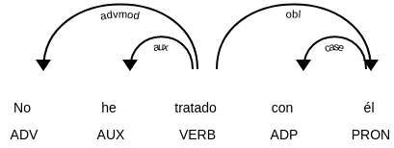
TOKENIZATION
02 NATURAL LANGUAGE PROCESSING
PART-OF-SPEECH
Segmentation of text into words, punctuations and stop words.
Deduction of word’s type, genre, number, etc. Also know as ‘Linguistic annotations’
Subfield of Artificial Intelligence which studies how computers process and analyze large amounts of natural language data.
“Let’s go to N.Y.!”
Token | No | he | tratado | con | él
POS | Adv | Aux | Verb | Adp | Pron
Tags | Neg | Sing 1Pers present | Past, Part | Prep | Masc Sing 3Pers
“
Let’s
go
to
N.Y.!
”
“
Let
’s
go
to
N.Y.
!
”
SENTENCE DETECTION
DEPENDENCY PARSING
Finding and segmenting individual sentences.
LEMMATIZATION
Detection of the relation between words in the sentence.
Extraction of the base form from a word.
She is a great teacher that works a lot. But he arrives allways late.
Working
work
She is a great teacher
that works a lot
But he arrives allways late
Are
be

Slide 7
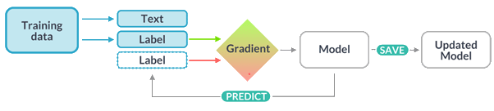
TEXT CLASSIFICATION
RULE-BASED MATCHING
02 NATURAL LANGUAGE PROCESSING
Process of categorizing text into different groups using a set of sample text labeled by a user and using an statistical model.
Process of defining patterns based on the contents and grammar of the sentence to identify text that match with defined patterns.
It’s based in Part-of-speech and Dependency Parsing and it’s also called as Pattern Matching.
Estimation of weight values base on examples.
Comparation between estimation and labels.
Measure of gradient to valuate result.
Iterative re-estimation of weights.
Regular expressions
Use of lemmas
Lower case of word contains ‘profes’
Lemma of word is ‘teach’
Use of dependencies
Subject of sentence is ‘profe’ and verb is ‘teach’ and object is ‘student’
Words position
Use of grammar
Sentence starts with word of pattern ‘A’
The first word it’s a noun followed by an adjective

Slide 8





Speech recognition
Word sense disambiguation
Sentiment analysis
02 NATURAL LANGUAGE PROCESSING
Use cases:
Natural language generation
Tools or libraries:
Natural Language Toolkit (NLTK)
TextBlob
Stanford Core NLP
Allen NLP
spaCy - Industrial-Strength NLP

Slide 9
03
METHODOLOGY AND SCHEDULING
Project starts
Data collection Working methodology Spacy initial explor.
Iteration 1
User interf. validat. Django exploration
Database definition
Iteration 2
Spacy deep explor.
Adapt data to NLP
Load data inJupyter
Iteration 4 NLP Spacy
model 1 with TextCategorizer
Iteration 6 and 7
Adv. user interface Import surveys and comments
Iteration 9
NLP Spacy model issue type 2 implementation
Master’s Final Project presentation
JUL
SEP
NOV
GEN
MAR
MAY
JUL
AUG
OCT
DEC
FEB
APR
JUN
Iteration 1
Data transformation User interface def. Spacy advan. explor.
Iteration 1
User interface implem.
Database implem.
Iteration 3
Language detection and enhancement
Iteration 5
NLP Spacy
model 1 with
Part-of-Speach
Iteration 8
Integration of NLP Spacy model 1 in Django user interf.
Iteration 10
Integration of NLP Spacy and Django
Documentation

Slide 10
04
DEVELOPMENT
Iteration 1. User interface definition
Iteration 2. Load of sample files and language detection
Iteration 3. Analysis and improvement of language detection
Iteration 4. NLP Spacy model 1. Issue ‘No ha impartit clase’. Option ‘TextCategorizer’
Iteration 5. NLP Spacy model 1. Option ‘Parts-of-speech’
Iteration 6. User interface implementation
Iteration 7. Import surveys and comments
Iteration 8. Integration of Spacy model 1 in Django user interface
Iteration 9. NLP Spacy model 2. Issue ‘Comentari problemàtic’
Iteration 10. Integration of Spacy model 2 in Django user interface

Slide 11
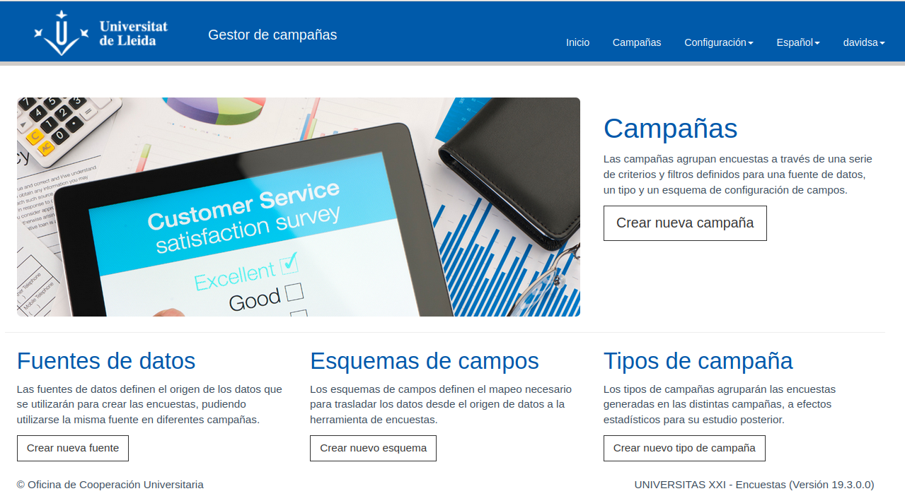
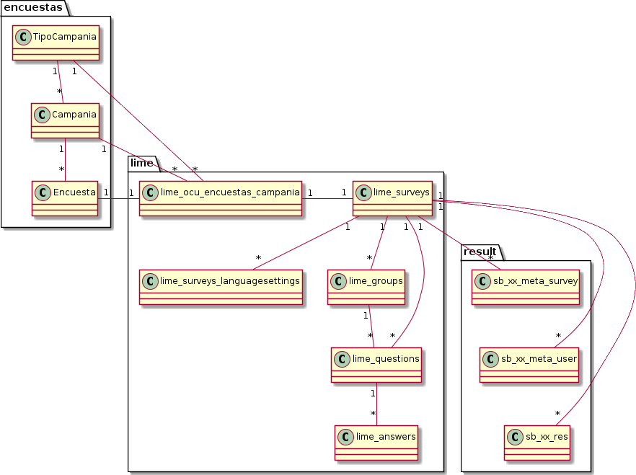
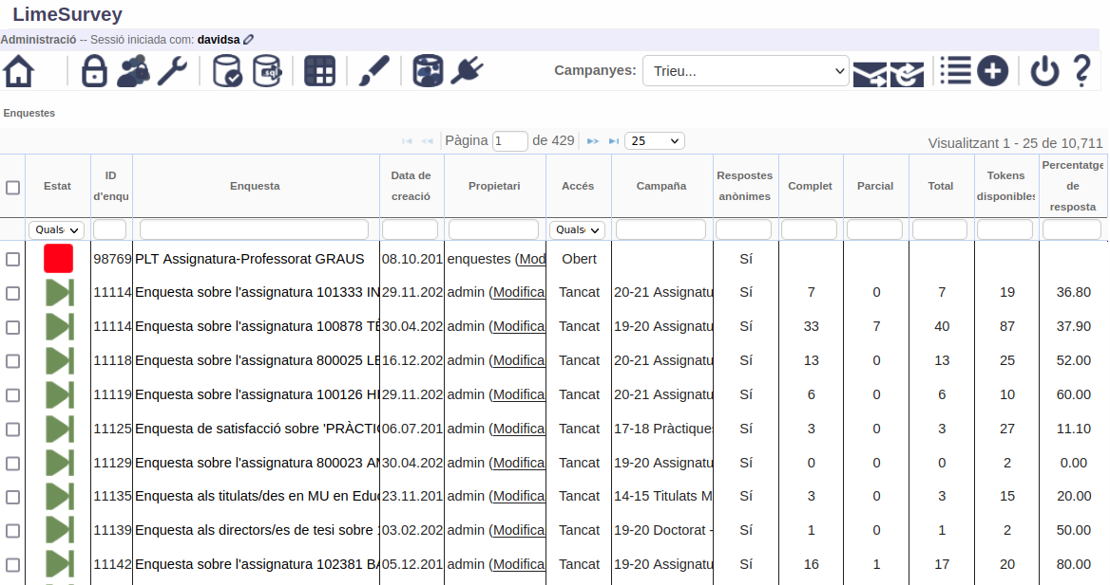
04
DEVELOPMENT
Iteration 1. User interface definition
Original system
Gestor campañas (OCU)
Database (MySQL)
Lime Survey (Open source)

Slide 12
04
DEVELOPMENT
Iteration 1. User interface definition
Behaviour Driven Development (BDD)
List of features:
Example of feature
Authenticate
List campaigns
List survey comments
View survey comment
Edit comment
Import surveys
Process comments
Feature: List Campaigns
In order to list the campaigns imported from Lime
As a user
I want to see a list of all imported campaigns
Example of scenario
Background: There is a registered user
Given Exists a user "user" with password "password"
Scenario: Select a campaign from a list
Given I login as user "user" with password "password"
And A set of campaigns had been imported from Lime
| cod_campania_lime | fecha_extraccion_lime | name | type_campaign_id |
| 101 | 2019-10-18 | 18-19 Assignatura-professor màsters P 1r S | 25 |
When I list the campaigns
Then I'm viewing a list of campaigns
| Codi campanya | Nom campanya | Codi tipus campanya | Data extacció |
| 168 | 19-20 Pràctiques externes-estudiantat (GEM-1P) | 9 | 2020-11-17 |

Slide 13
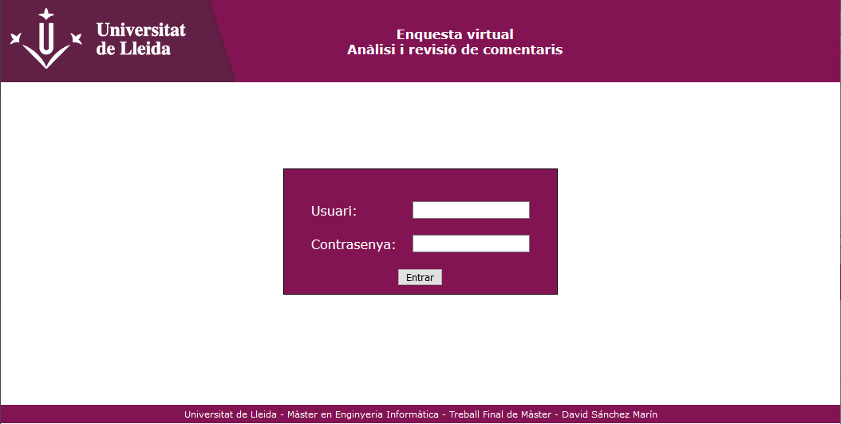
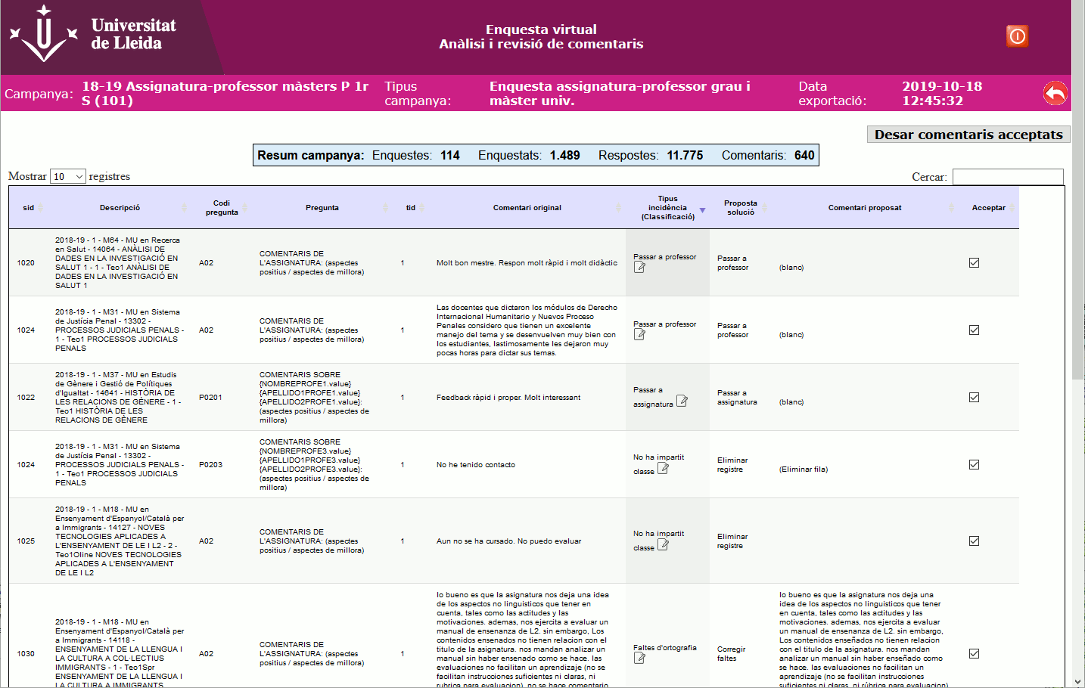
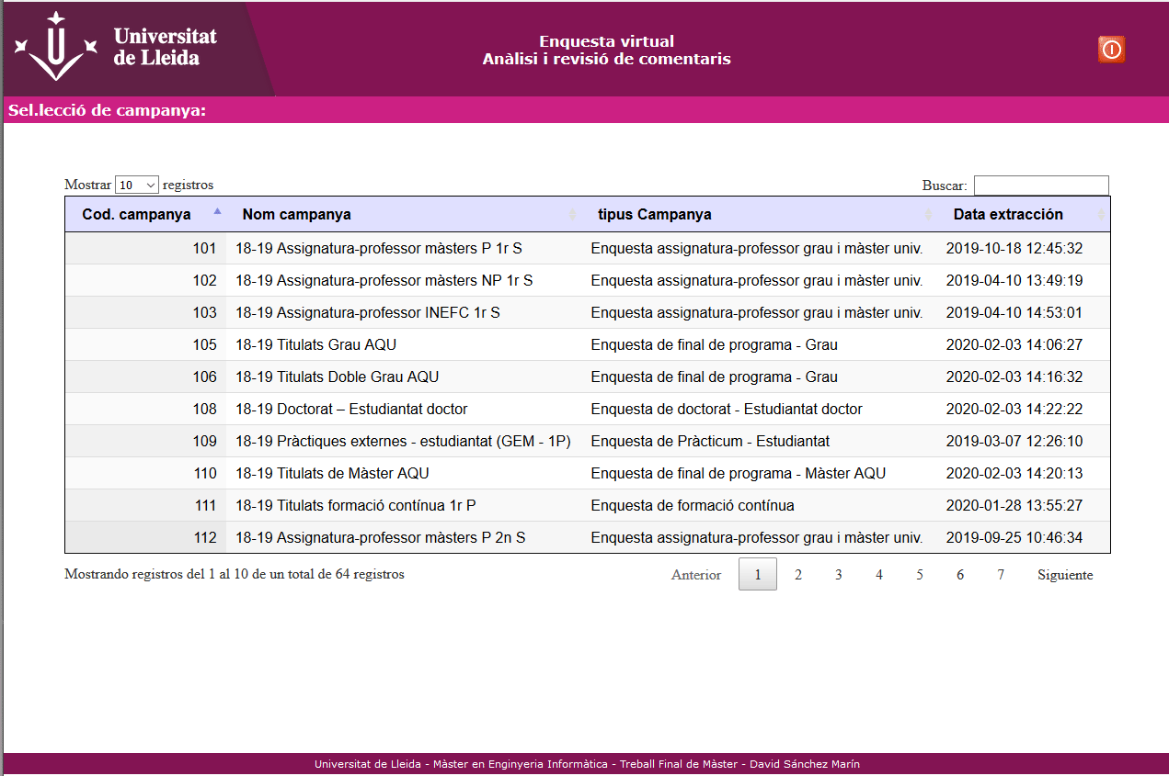
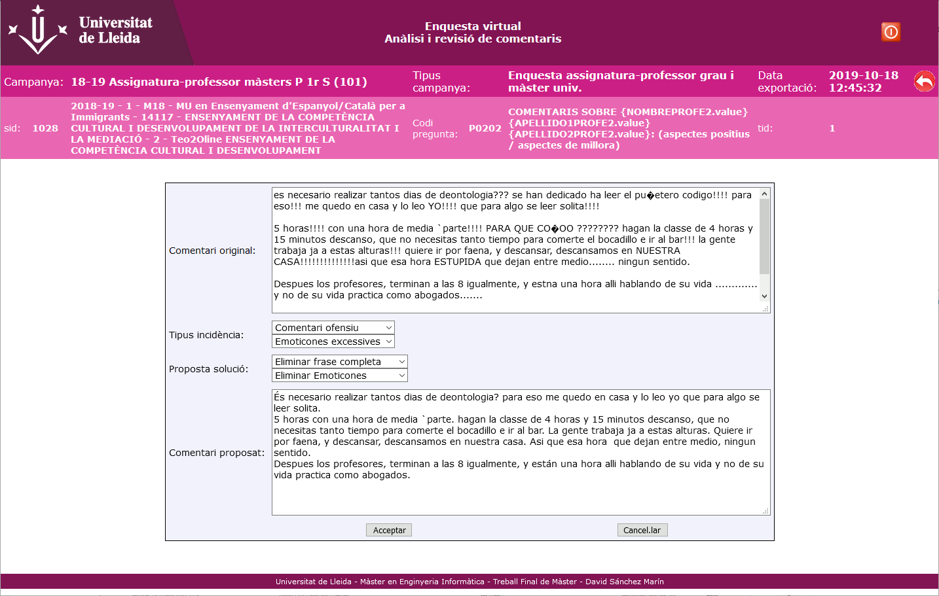
04
DEVELOPMENT
Iteration 1. User interface definition
Authentication:
List survey comments
Process
comments
Edit survey comment
Import surveys
List campaigns
View survey comment

Slide 14
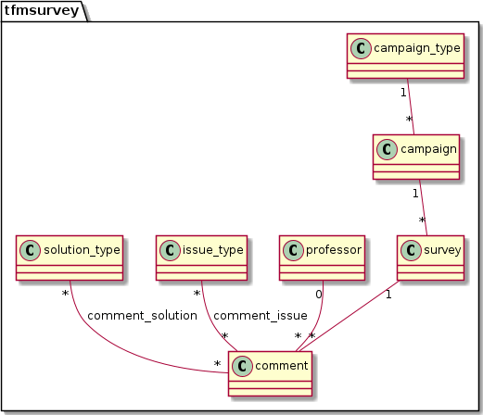
04
DEVELOPMENT
Iteration 1. User interface definition
Database (MySQL)
Issue types
The professor has not taught this group
Problematic comments
Offensive comments
Professor comment on subject question
Subject comment in professor question
Spelling mistakes
Exclamation points and excessive emoticons

Slide 15
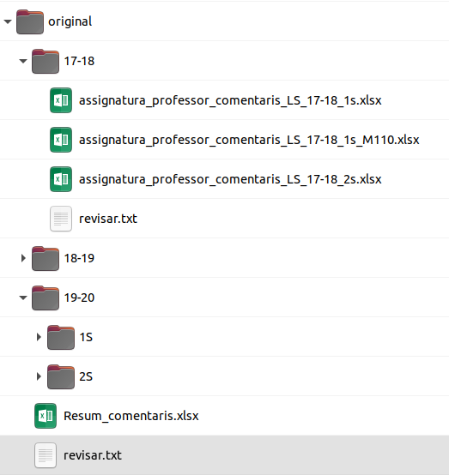
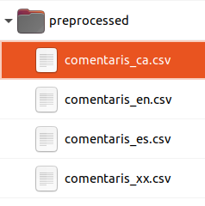
04
DEVELOPMENT
Iteration 2 and 3. Load sample files and language detection
Implementation
Load_data.ipynb
(Jupyter Notebook)
LanguageDetector
PyCld2
Python 3.8
Jupyter 6.1.4
Pandas 1.1.3
Spacy 2.3
PyCld2 0.41

Slide 16
04
DEVELOPMENT
Iteration 2 and 3. Load sample files and language detection Results
Comments by issue type:
Issue type | Total | %
Comentari problemàtic | 271 | 53.88%
No ha impartit classe a aquest grup | 115 | 22.86%
Comentari de professor | 53 | 10.54%
Faltes d'ortografia | 18 | 3.58%
Canvi de professor | 17 | 3.38%
Comentari ofensiu | 11 | 2.19%
Comentari d'assignatura | 7 | 1.39%
Duplicar a professor | 5 | 0.99%
Comentari excel·lent | 4 | 0.80%
Exclamacions o emoticones excessius | 2 | 0.40%
Total | 503
Comments by year:
Academic year | Total | Percentage
2017-18 | 90 | 1,14%
2018-19 | 1,468 | 18,56%
2019-20 | 6,353 | 80,31%
Total | 7,911

Slide 17
04
DEVELOPMENT
Iteration 2 and 3. Load sample files and language detection Language enhancement
Language libraries comparative
Decision table
 | Idioma PyCld2
Idioma Spacy | ca | es | en | xx | Total
ca | 5,815 | 11 | 141 | 31 | 5,998
es | 16 | 1,297 | 19 | 13 | 1,345
en | 60 | 8 | 239 | 25 | 324
xx | 68 | 28 | 30 | 55 | 181
Total | 5,959 | 1,336 | 429 | 124 | 7,848
 | Idioma PyCld2
Idioma Spacy | ca | es | en | xx
ca | ca | ca | ca | ca
es | ca | es | es | es
en | ca | es | en | ca
xx | ca | es | ca | ca/es
Comment by language
Divergence: | 497 | 6,3%
ca | es | en | xx
6,197 | 1,365 | 239 | 55
78.9% | 17.4% | 3.0% | 0.7%

Slide 18
04
DEVELOPMENT
Iteration 4. NLP Spacy model 1. Issue
‘No ha impartit clase’ - Option ‘Text classification’
Load data
Only models to Catalan and Spanish languages
Division of comments in training and test sets: 80% / 20%
Division of sets in positive and negative cases
Only questions about professors
Inclusion of all the positive cases
Selection of a subset of negative cases

Slide 19
04
DEVELOPMENT
Iteration 4. NLP Spacy model 1. Issue
‘No ha impartit clase’ - Option ‘Text classification’
Train model
model_no_classe_lang_2.ipynb
TextCategorizer
Limited training data
Loop until Gradient < 0.001
Creation of subsets of data (batches):
Compounding
Minibatch
Shuffle

Slide 20
04
DEVELOPMENT
NLP Spacy model 1. Issue
‘No ha impartit clase’ - Option ‘Text classification’
Evaluate
 |  | User label
 |  | Positive | Negative
Prediction | Positive | True positives (TP) | False Positives (FP)
 | Negative | False negatives (FN) | True negatives (TN)
Confusion table:
Precision (P) =
TP
TP + FP
Indicators
Recall (R) =
TP
TP + FN
F-score (F) =
2 * P * R
P + R

Slide 21
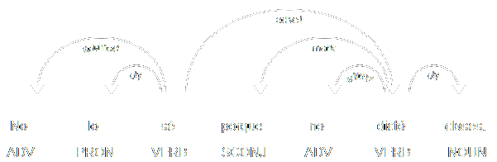
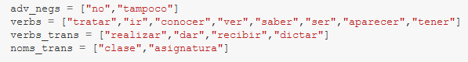
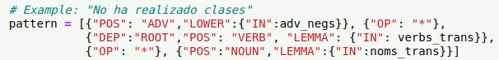
04
DEVELOPMENT
Iteration 5. NLP Spacy model 1
Option ‘Rule-based matching’
model_1_no_classes_part-of-speech_train.ipynb
model_1_no_classes_part-of-speech_evaluate.ipynb
Matcher
Based on Part-of-speech and Dependency parser
Transitive verbs:
Starts with negative adverb
Contain a verb from the verbs_trans list
Follows a noun from the noms_trans list
Non-transitive verbs:
Starts with negative adverb
Contain a verb form the verbs list
Rule for transitive verb:

Slide 22
04
DEVELOPMENT
Iteration 5. NLP Spacy model 1
Option ‘Rule-based matching’
Precision (p) | Recall (r) | F-score (f)
37.50% | 78.95% | 50.84%

Slide 23
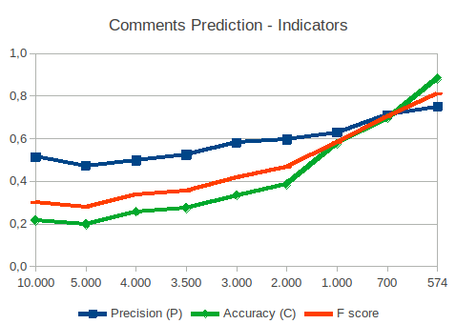
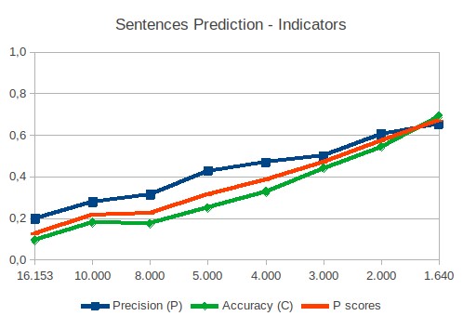
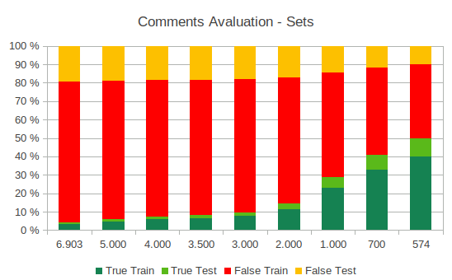
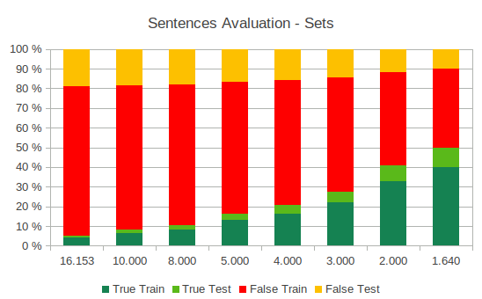
04
DEVELOPMENT
Iteration 9. NLP Spacy model 2
Issue ’Comentari problemàtic’
Characteristics:
Long comments with more than one sentence
Don’t follow a clear pattern or regular expressions
Only Catalan and Spanish languages
Comparative of strategies and set sizes. Catalan languages
Options:
Strategy: Full comments vs Individual sentences
Sets size: Training vs test and Positive vs negative
Pre-trained model: Large or small models
Conclusion:
Full comments
700 comments (40% positives)

Slide 24
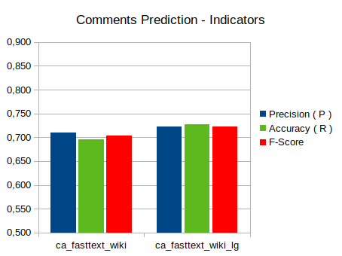
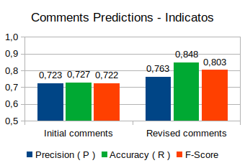
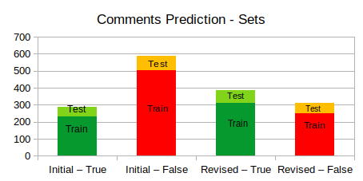
04
DEVELOPMENT
Iteration 9. NLP Spacy model 2
Issue ’Comentari problemàtic’
Comparative of pre-trained models
False positives problem:
Most of the False positives could be True positives
Reclassification of False positives comments: 100 new positives
Results: Accuracy increase 8% F-score: 12%
Results of comments revision

Slide 25
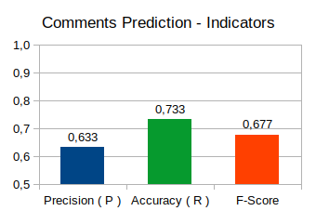
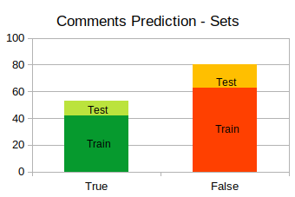
04
DEVELOPMENT
Iteration 9. NLP Spacy model 2
Issue ’Comentari problemàtic’ Spanish language
Only 53 positives comments
Parameters:
- Full comments analysis - 40% positive cases - Set size: 133 comments - Large pre-trained model

Slide 26
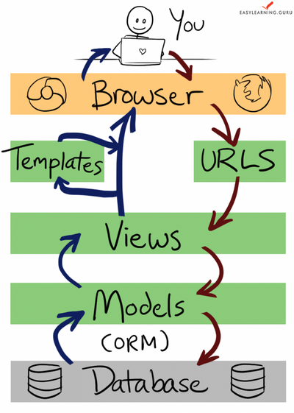
04
DEVELOPMENT
Iteration 6. User interface implementation Django framework
Django is a high-level Python web framework that provide a lot of infrastructure and tools to help in the development.
His basic components are:
Models: Definition of the objects and properties corresponding to the tables and fields of the database. Automate the management between the application and the database
URLs: External addresses accessed by the user. This component redirects to the real pages and manage the parameters
Views: Responsible of executing the logic of the application. It obtains the information from Models, redirect to URLs and send results to them.
Templates: Html pages with the format of the pages. They will be mixed with the information from views and can include other templates.

Slide 27
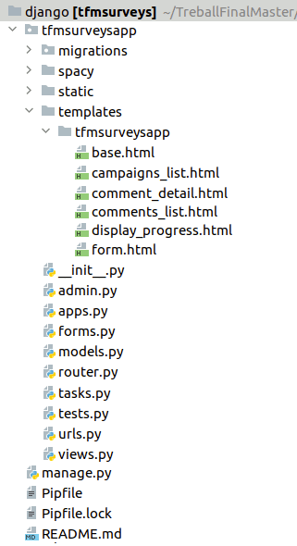
04
DEVELOPMENT
Iteration 6. User interface implementation Models
/tfmsurveysapp/models.py
class CampaignType(models.Model):
...
class Campaign(models.Model):
...
class Survey(models.Model):
...
class Professor(models.Model):
...
class IssueType(models.Model):
...
class SolutionType(models.Model):
...
class Comment(models.Model):
...
class CommentIssue(models.Model):
...
class CommentSolution(models.Model):
...
class Campaign(models.Model):
type_campaign = models.ForeignKey(CampaignType, on_delete=models.CASCADE)
cod_campania_lime = models.IntegerField("Codi campania Lime")
fecha_extraccion_lime = models.DateField("Data extracció Lime")
name = models.CharField("Nom", max_length=50)
import_date = models.DateField("Data importació")
estat = models.CharField("Estat", max_length=50, null=True)
subestat = models.CharField("Subestat", max_length=50, null=True)

Slide 28
04
DEVELOPMENT
Iteration 6. User interface implementation URLs
Examples of urls
List campaigns: http://localhost/tfmsurveys/campaigns/
List survey comments: http://localhost/tfmsurveys/campaigns/22/ Campaign code=22
View survey comment: http://localhost/tfmsurveys/campaigns/22/23405/ Campaign code=22, Comment code=22
/tfmsurveysapp/urls.py
path('campaigns/<int:cod_campania_lime>',
CommentsList.as_view(),
name='comments_list'),

Slide 29
04
DEVELOPMENT
Iteration 6. User interface implementation Views
View’s example 1
/tfmsurveysapp/urls.py
def campaigns_list(request):
campaigns_list=Campaign.objects.all()
context = {'campaigns_list': campaigns_list}
return render(request, 'tfmsurveysapp/campaigns_list.html', context)
Def campaign_list(request): ... class CommentsList(ListView): ... class CommentDetail(UpdateView) ...
View’s example 2
class CommentsList(ListView):
model = Comment
context_object_name = 'comments_list'
template_name = 'tfmsurveysapp/comments_list.html'
def get_queryset(self):
comments_list = Comment.objects
.filter(survey__campaign__cod_campania_lime=
self.kwargs['cod_campania_lime’])
self.total_count = comments_list.count()
return comments_list
def get_context_data(self, **kwargs):
context = super(CommentsList, self).get_context_data(**kwargs) context['total_count'] = self.total_count
return context

Slide 30
04
DEVELOPMENT
Iteration 6. User interface implementation Templates
Example of template: /tfmsurveysapp/templates/tfmsurveysapp/campaigns_list.html
{% extends "tfmsurveysapp/base.html" %}
{% block content %}
{% load static %}
...
<table align="center" id="Lista" class="display" >
...
{% for campaign in campaigns_list %}
<tr>
<td align="center">{{ campaign.cod_campania_lime }}</td>
<td>{{ campaign.name }}</td>
<td align="center">{{ campaign.type_campaign_id }}</td>
<td>{{ campaign.type_campaign.name }}</td>
<td align="center">{{ campaign.fecha_extraccion_lime|date:'d-m-Y' }}</td>
<td align="center">{{ campaign.import_date|default_if_none:" "|date:'d-m-Y' }}</td>
<td>
<a href="{% url 'tfmsurveysapp:comments_list' campaign.cod_campania_lime %}" target="_self“>
Veure
</a>
</tr>
{% endfor %}
</table>
...
{% endblock %}

Slide 31
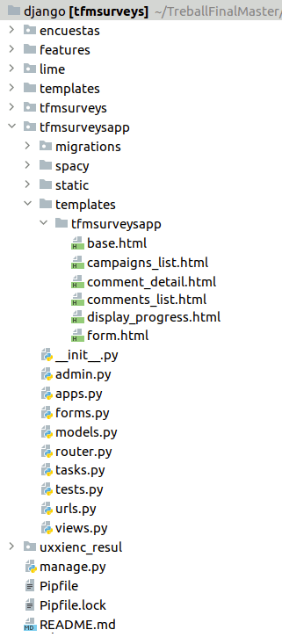
04
DEVELOPMENT
Iteration 7. Import surveys and comments Multiple legacy databases access
The original application LimeSurvey include 3 database schemas:
Encuestas
Lime
uxxienc_resul
encuestas
lime
uxxienc_resul
Note:
model.py
TipoCampania
Campania
Encuesta
model.py
LimeOcuEncuestasCampania
model.py
CampaniasExtraidas
SBMetaSurvey
SBMetaUser
SBRes
SBProf
SBMetaSurvey, SBMetaUser,
SBRes and SBProf:
Raw queries and Multifield keys
Router.py

Slide 32
04
DEVELOPMENT
Iteration 7. Import surveys and comments
Import Campaign
types and Campaigns
Import Surveys and Comments
- Executed when the user press Import button in Campaigns list
- Implemented in ImportCampaign view
- Based on RedirectView standard view class
- Executed when opening Campaigns list
- Implemented in campaigns_list view
encuestas
TipoCampania
uxxienc_resul
CampaniasExtraidas
encuestas
Encuesta
uxxienc_resul
SBProf
(raw query)
uxxienc_resul
SBRes
(raw query)
tfmsurveys
CampaignType
tfmsurveys
Campaign
tfmsurveys
Survey
(bulk_create)
tfmsurveys
Professor
tfmsurveys
Comment
(bulk créate)

Slide 33
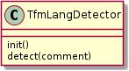
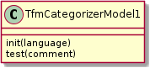
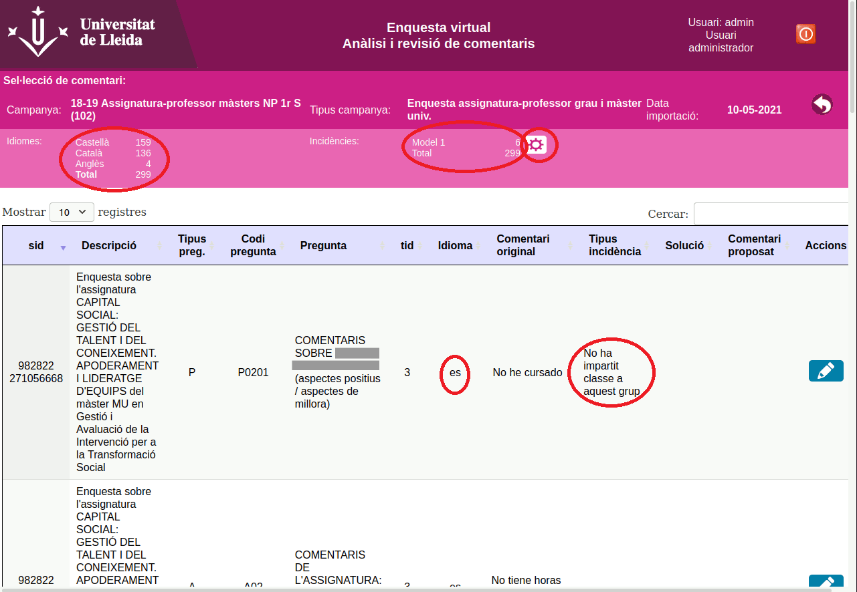
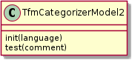
04
DEVELOPMENT
Iteration 8 and 10. Integration of Django and Spacy
Executing process
Showing results
Url:
http://localhost/tfmsurveys/campaigns/22/process/
Urls:
http://localhost/tfmsurveys/campaigns/22/lang/ca
http://localhost/tfmsurveys/campaigns/22/issue/1
New classes
Changes in views
Changes in views
Changes in template
ImportCampaign (RedirectView)
Import_comments
CommentList (ListView)
comments_list.filter
comments_list.count
comments_list
Process comments button
- Languages summary - Issue types summary - Language column - Issue type column
ProcessComments
(RedirectView)
Process_models
Celerys task
process_model 1
process_model 2

Slide 34
05
CONCLUSIONS
The aim of this Project was to develop an application that helps the Quality unit of the UdL manage the free comments included in the teaching surveys.
The main features of this application are:
Importation of campaigns, surveys and comments from Lime Survey.
List and search of campaigns, surveys and comments.
Manual edition of comments.
Processing of comments to identify their language and classify them in the issue types “Professor didn’t teach this group” and “Problematic comments”.

Slide 35
05
CONCLUSIONS
I used Behaviour Driven Development methodology to define the requirements.
I defined the features for the high-level structure and scenarios for the detailed description.
I developed the user interface with Python and the Django framework.
I implemented its main components: Models, Views, Urls and Templates, but also access to legacy databases, virtual models, raw queries and others.
I analyzed and classified comments using the Spacy library.
I detected the language of comments with LanguageDetector and classified them in issue types with TextCategorizer and Part-of-Speech.

Slide 36
THANKS
Does anyone have any questions?
Student: David Sánchez Marín
Director: Roberto García Master’s Final Project
Master’s degree in Informatics Engineering
Polytechnic School
University of Lleida

Slide 37
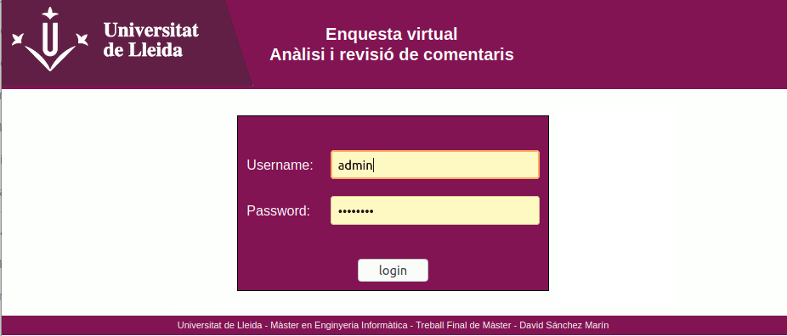
Annex. Screens Authentication

Slide 38
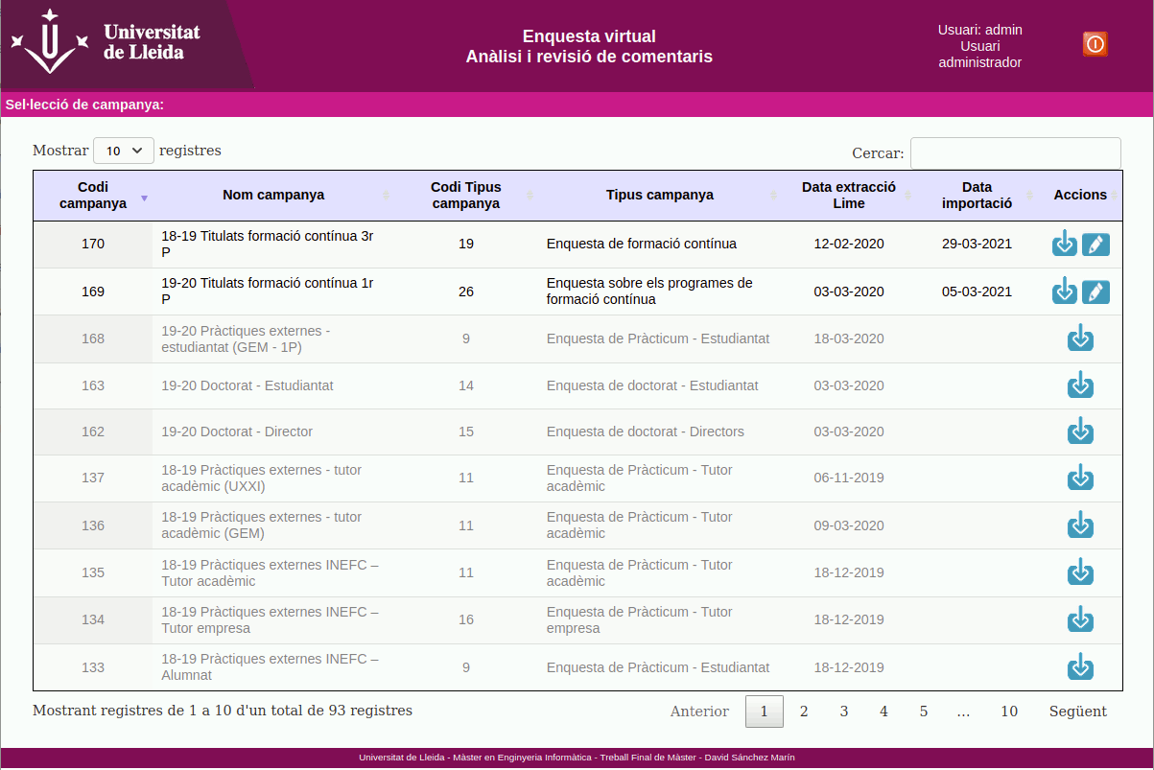
Annex. Screens Campaigns list

Slide 39
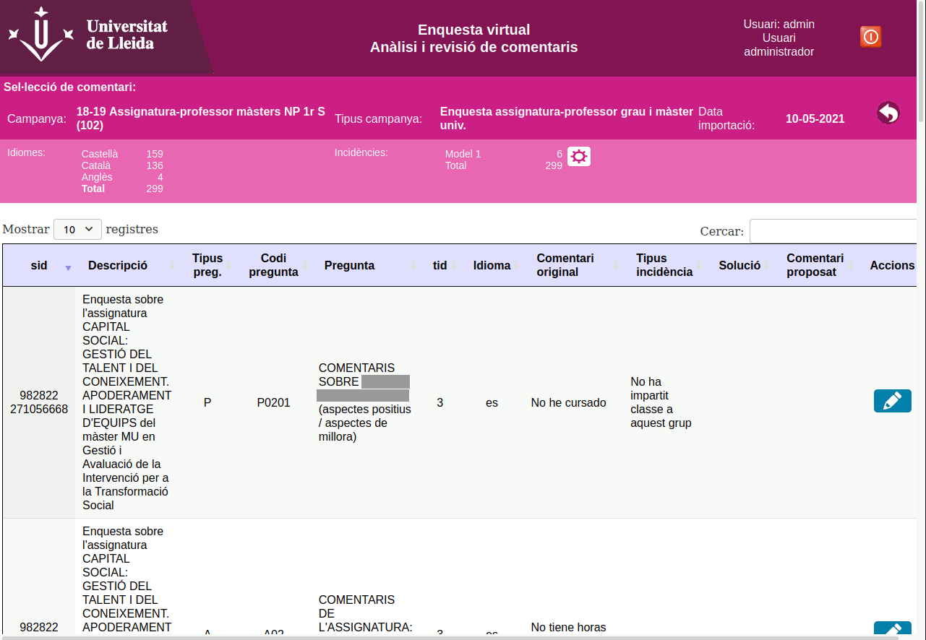
Annex. Screens Surveys and comments list

Slide 40
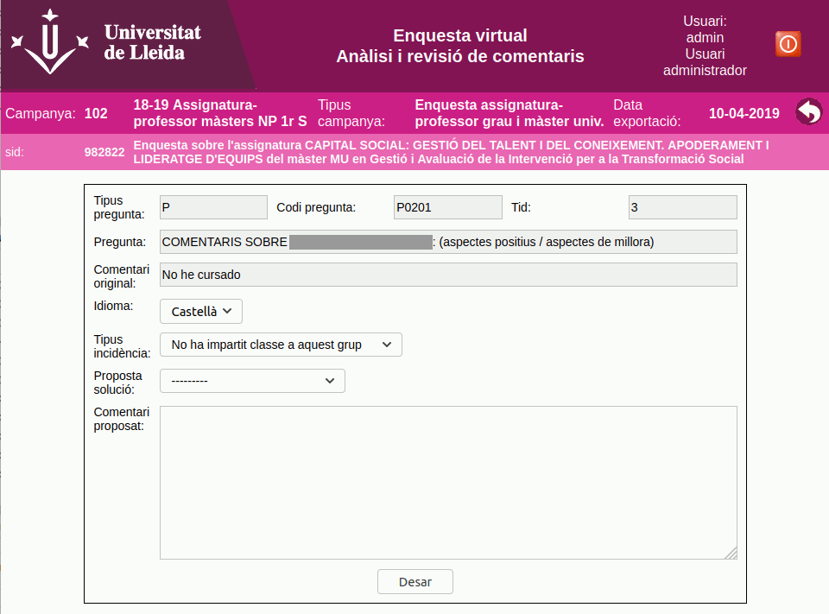
Annex. Screens Edit comment

